Slide 1
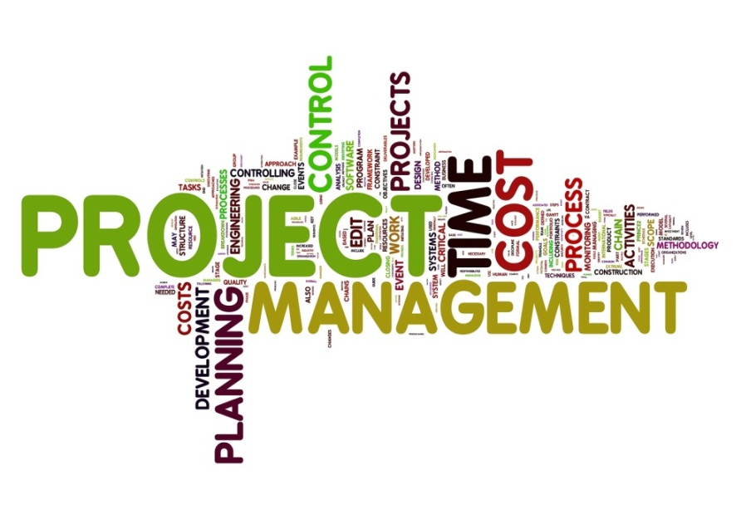
Labs IT Projects
Labs IT Dev Workspace
MyLab Migration to Monsoon
Overcoming Latency- Additional
Investigating Bare Metal Solutions
Remote Connection to Mac- Project
Chameleon
Mobile Device Pool- Perfecto Mobile
Expansion of App Haus in Bangalore Labs
Setup of Innovation Center Bangalore Campus to showcase SAP products
Upgrade the Virtual Infrastructure Landscape in Labs India to meet the additional demand
Rollout of Microsoft Lync as a unified communications platform in all Countries
Provisioning of second Telepresence Room in Labs India Bangalore and Palo Alto
Work with the Global Integration team on the Ariba M&A activities
Labs IT GLDS
Non Abap Software Production Services
Integrate Sybase Dev Landscape
Innovation Landscape Renewal
GIT Source Code Management Landscape
POC on Cloud Frame for HANA Server
Provisioning
Monsoon Cutover
Replace NIS for Server Provisioning
TD VIM OS Support
Puppet Rollout in GLDS

